Slide 1
PHD Notes
Ferdinand Wöhr
EG-2-CE

Slide 2
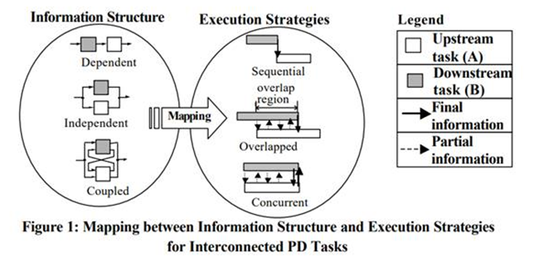
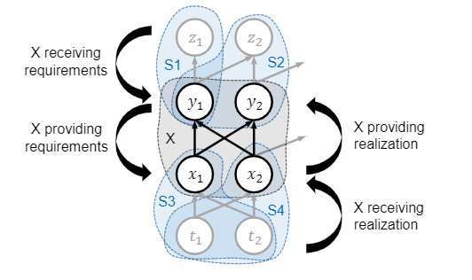
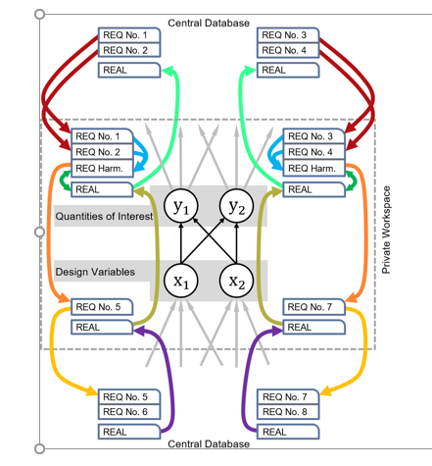
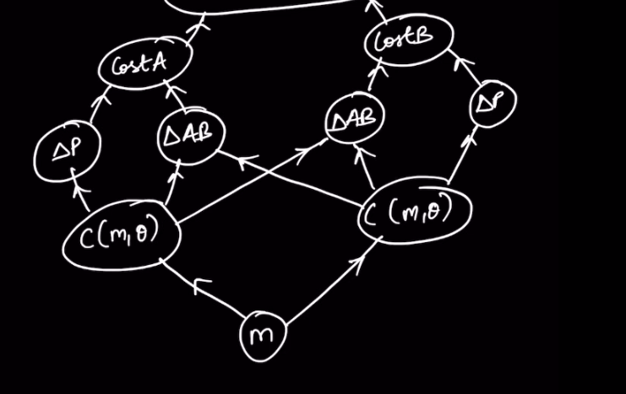
…
When is there no direct mapping (i.e. independent tasks may also be performed sequentially)
How does task dependency and task execution relate to an ADG?
Task dependency
Task execution
C_A
C_B
x_2
x_1
m1
m2
m3
A
m1
m2
m3

Slide 3





x
y_1
y_2
x
X_1
X_2
$${[x}_{A0},y_{A0}]$$
B
A
$$x_{A}={[x}_{A0},y_{A0},l_{A1},θ_{A1}]$$
$$x_{B}={[x}_{B0},y_{B0},l_{B1},θ_{B1}]$$
$$x_{A}={[x}_{A0},y_{A0},l_{A1},l_{A2},θ_{A1},θ_{A2}]$$
$$x_{B}={[x}_{A0},y_{A0},l_{A1},l_{A2},θ_{B1},θ_{B2}]$$

Slide 4
